Slide 1
Providing Visualizations for Distributed Version Control Systems
Cristiano Cesário - ccesario@ic.uff.br
Instituto de Computação – Universidade Federal Fluminense (UFF)
DyeVC is available at http://gems.ic.uff.br/dyevc

Slide 2
Concept: Centralized x Distributed Repositories
Introduction
Motivation
Related Work
Approach
Conclusion
Evaluation
Repository
Repository
(bare)
check-in / commit
check-out / update
clone / pull
push
Repository
(non-bare)
Workspace
check-out / update
check-in
Workspace
Centralized Repository
Distributed Repository

Slide 3
Concept: Centralized x Distributed Repositories
Introduction
Motivation
Related Work
Approach
Conclusion
Evaluation
Workspace
Repository
Repository
clone / pull
check-out / update
check-in / commit
push
Repository
check-out / update
Workspace
commit
Workspace
(a)
(b)

Slide 4
Motivation
Introduction
Motivation
Related Work
Approach
Conclusion
Evaluation
master
1
2
3
master
master
master
1
2
3
1
2
3
4
6
1
2
3
4
6
8
5
7
5
7
issue55
issue55
issue55
(a)
(b)
(c)
Notes:
Physical distance
Time zone disparity
Domain expertise
Architecture
Software integration
Software conf. mngt.
Vendor support
Governmental issues
Development process
Local impression of remote terms

Slide 5
Motivation
Introduction
Motivation
Related Work
Approach
Conclusion
Evaluation
Original repository
Clones
1
2
3
4’
5’
6’
Clone A
1
2
3
1
2
3
4’’
Clone B
1
2
3
4’’’
5’’’
6’’’
7’’’
Clone C
Notes:
Physical distance
Time zone disparity
Domain expertise
Architecture
Software integration
Software conf. mngt.
Vendor support
Governmental issues
Development process
Local impression of remote terms

Slide 6
Motivation
Introduction
Motivation
Related Work
Approach
Conclusion
Evaluation
Original repository
Clones
1
2
3
4’’
Clone B
1
2
3
4’
5’
6’
1
2
3
4’’’
5’’’
6’’’
7’’’
Clone C
Original repository
Clones
1
2
3
4’’
5’’
Clone B
1
2
3
4’
5’
6’
4’
5’
6’
1
2
3
4’’’
5’’’
6’’’
7’’’
Clone C
Notes:
Physical distance
Time zone disparity
Domain expertise
Architecture
Software integration
Software conf. mngt.
Vendor support
Governmental issues
Development process
Local impression of remote terms

Slide 7
Motivation
Introduction
Motivation
Related Work
Approach
Conclusion
Evaluation
Original repository
Clones
1
2
3
4’’
5’’
1
2
3
4’’’
5’’’
6’’’
7’’’
Clone C
4’
5’
6’
Original repository
Clones
1
2
3
4’’
5’’
1
2
3
4’’’
5’’’
6’’’
7’’’
8’’’
Clone C
4’
5’
6’
4’’
5’’
4’
5’
6’
Notes:
Physical distance
Time zone disparity
Domain expertise
Architecture
Software integration
Software conf. mngt.
Vendor support
Governmental issues
Development process
Local impression of remote terms

Slide 8
Motivation
Introduction
Motivation
Related Work
Approach
Conclusion
Evaluation
Original repository
Clone B
master
master
1
2
3
4’
5’
6’
1
2
3
4’’
4’
5’
6’
Origin/master
Original repository
master
Clone B
master
1
2
3
4’’
5’’
1
2
3
4’’
5’’
4’
5’
6’
4’
5’
6’
Origin/master
Notes:
Physical distance
Time zone disparity
Domain expertise
Architecture
Software integration
Software conf. mngt.
Vendor support
Governmental issues
Development process
Local impression of remote terms

Slide 9
Motivation
Introduction
Motivation
Related Work
Approach
Conclusion
Evaluation
master
1
2
3
4
5
Notes:
Physical distance
Time zone disparity
Domain expertise
Architecture
Software integration
Software conf. mngt.
Vendor support
Governmental issues
Development process
Local impression of remote terms

Slide 10
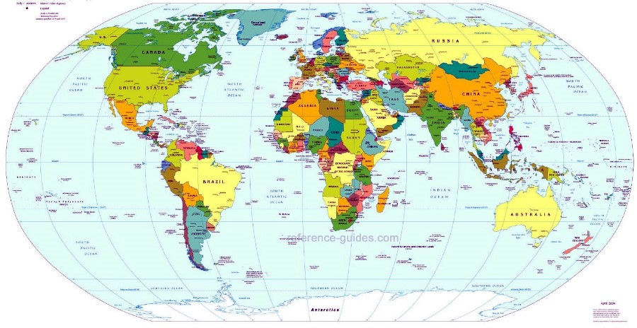
Motivation
Introduction
Motivation
Related Work
Approach
Conclusion
Evaluation
Globalization
Software development is also distributed
Risk factors [Battin et al. 2001]
Notes:
Physical distance
Time zone disparity
Domain expertise
Architecture
Software integration
Software conf. mngt.
Vendor support
Governmental issues
Development process
Local impression of remote terms

Slide 11


Motivation
Introduction
Motivation
Related Work
Approach
Conclusion
Evaluation
Difficult collaboration and awareness regarding changes
?

Slide 12
Motivation
Introduction
Motivation
Related Work
Approach
Conclusion
Evaluation
Increasing usage of distributed repositories
Source: Eclipse Foundation. The Open Source Developer Report - 2013 Eclipse Community Survey.

Slide 13
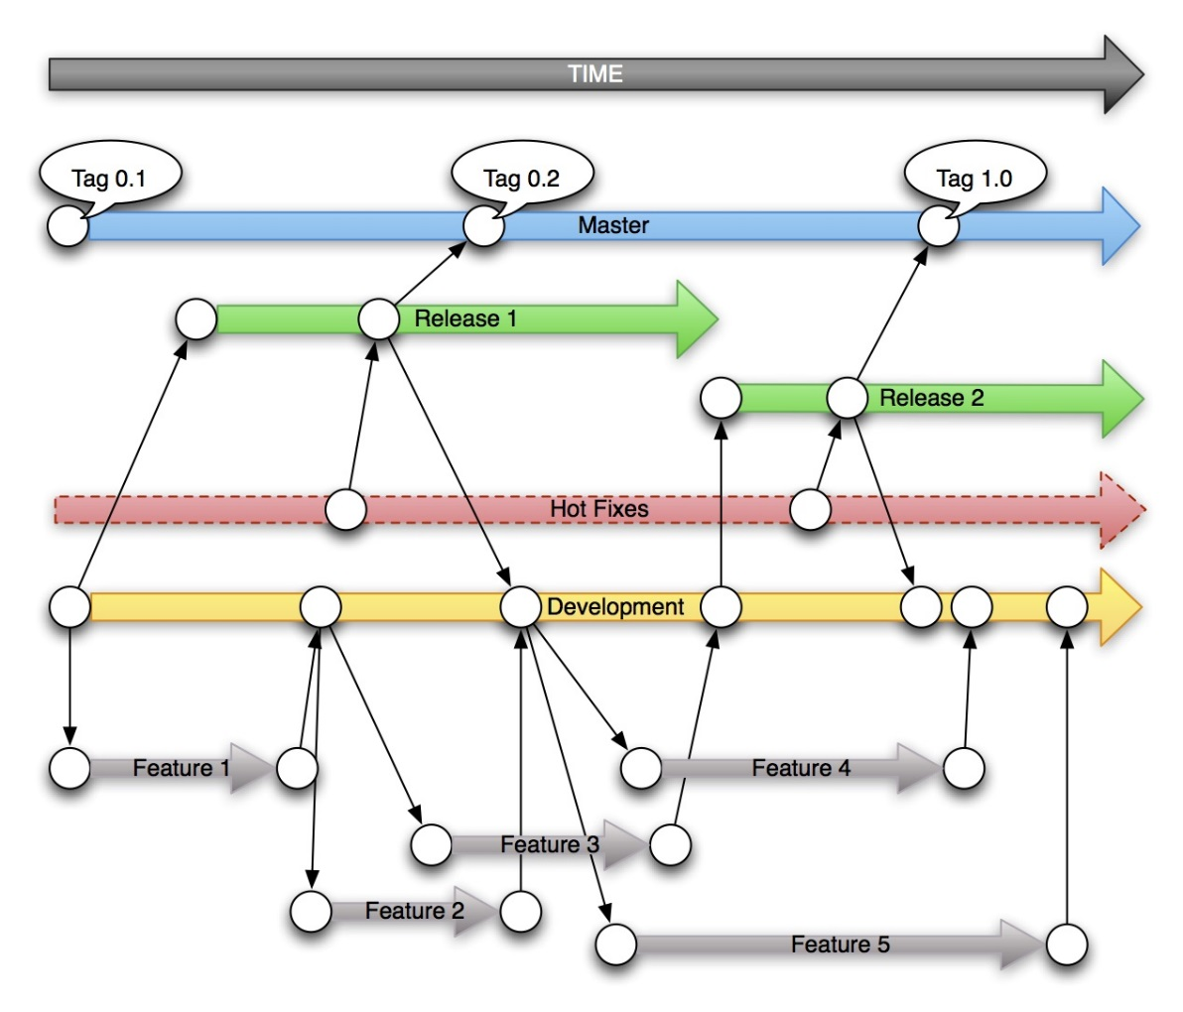
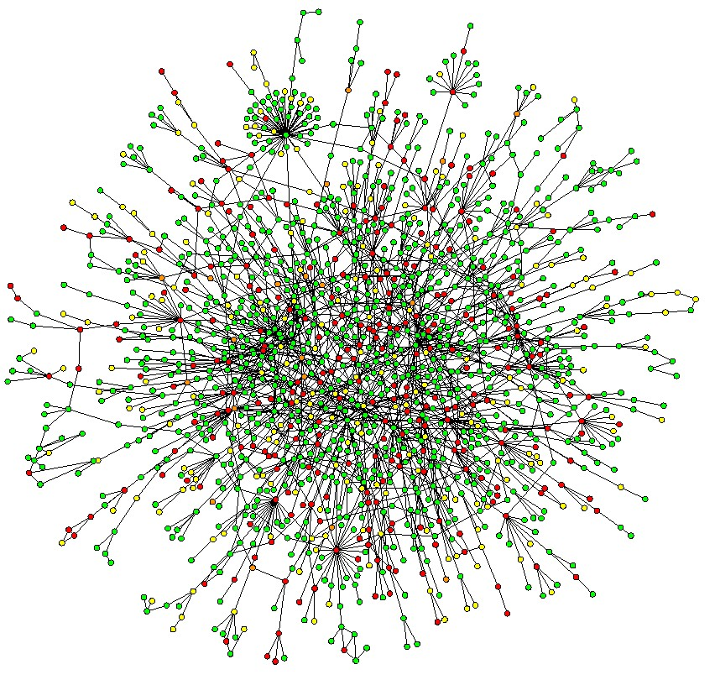
Motivation
Introduction
Motivation
Related Work
Approach
Conclusion
Evaluation
Increasing usage of distributed repositories
Branches
proliferation
Notes:
Proliferação de ramos

Slide 14



Motivation
Introduction
Motivation
Related Work
Approach
Conclusion
Evaluation
Xavier Institute
Wolverine
Storm
Gambit
Professor Xavier
Rogue
Nightcrawler
Cyclops
Jean Gray
Mystique
Beast

Slide 15
Motivation
Introduction
Motivation
Related Work
Approach
Conclusion
Evaluation
Xavier Institute
Wolverine
Storm
Gambit
Professor Xavier
Rogue
Nightcrawler
Cyclops
Jean Gray
Mystique
Push
Beast
Pull

Slide 16
Questions
Introduction
Motivation
Related Work
Approach
Conclusion
Evaluation
Developer
How can I know at a given moment if there are commits that were not pulled yet?
Are there any local commits pending to be pushed?
Administrator
What are the existing clones of a system?
Who and how do they relate with?
How can I know if there are pending commits to be sent from a test repository to a production one?

Slide 17
Related Work
Introduction
Motivation
Related Work
Approach
Conclusion
Evaluation
Awareness Tools
Conflict Avoidance
Conflict Detecting
Visualization
Repository Linearization

Slide 18
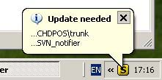
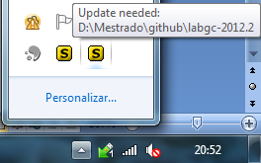
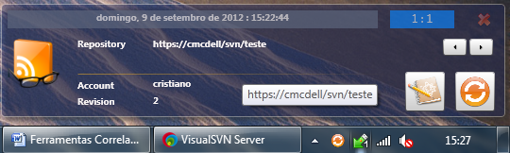
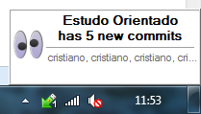
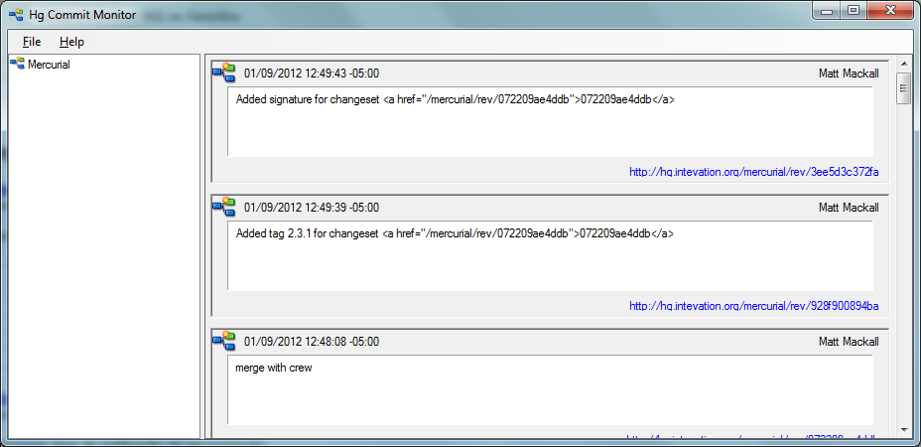
Related Work
Introduction
Motivation
Related Work
Approach
Conclusion
Evaluation
SVN Notifier
Elvin
SCM Notifier
SVN Radar
Commit Monitor

Slide 19
Related Work
Introduction
Motivation
Related Work
Approach
Conclusion
Evaluation
SVN Notifier
SCM Notifier
Commit Monitor
Elvin

Slide 20

Related Work - Awareness Tools
Introduction
Motivation
Related Work
Approach
Conclusion
Evaluation
Conflict avoidance
Report new commits
Do not identify related repositories
Do not present information in different levels
SVN Notifier¹, SCM Notifier², Commit Monitor³, SVN Radar⁴ and Hg Commit Monitor⁵
¹http://svnnotifier.tigris.org/ (2012)
²https://github.com/pocorall/scm-notifier (2012)
³http://tools.tortoisesvn.net/CommitMonitor.html (2013)
⁴http://code.google.com/p/svnradar/ (2011)
⁵http://www.fsmpi.uni-bayreuth.de/~dun3/hg-commit-monitor (2009)

Slide 21

Related Work - Awareness Tools
Introduction
Motivation
Related Work
Approach
Conclusion
Evaluation
Conflict detecting
CollabVS [Dewan and Hegde 2007], Crystal [Brun et al. 2011], FASTDash [Biehl et al.], Lighthouse [Da Silva et al. 2006], Palantir [Sarma and Van der Hoek 2002], Polvo [Santos and Murta 2012], WeCode [Guimarães and Silva 2012], Safe-Commit [Wloka et al. 2009]
Identify existing or potential conflicts
Only one supports DVCSs
Do not support scenarios with multiple partners

Slide 22
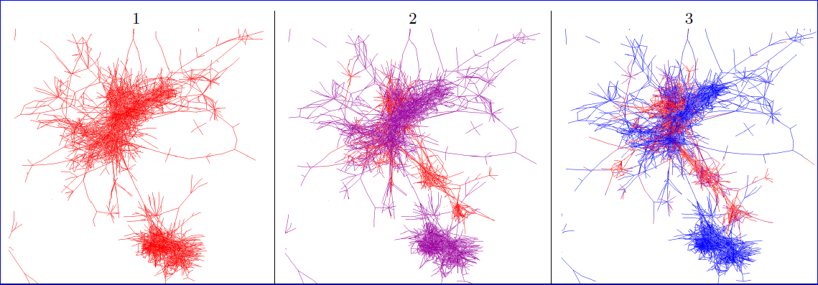
Related Work - Repository Linearization
Introduction
Motivation
Related Work
Approach
Conclusion
Evaluation
Gevol [Collberg et al 2003]: Focus on program structure

Slide 23
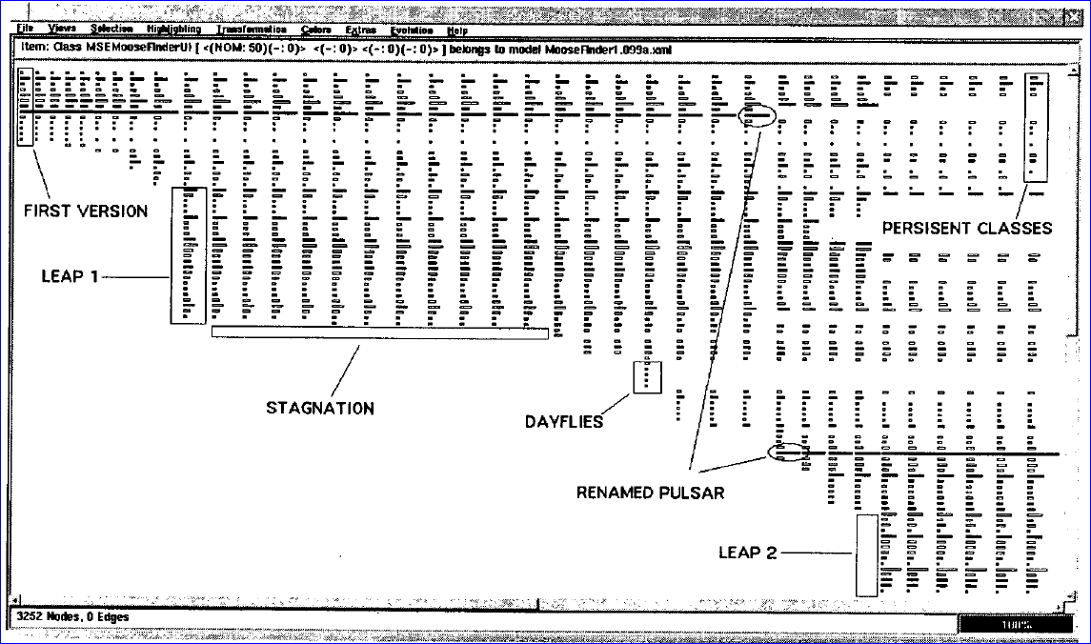
Related Work - Repository Linearization
Introduction
Motivation
Related Work
Approach
Conclusion
Evaluation
The Evolution Matrix [Lanza 2001]: Focus on classes

Slide 24
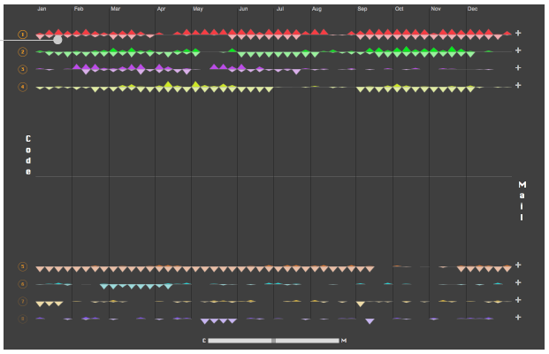
Related Work - Repository Linearization
Introduction
Motivation
Related Work
Approach
Conclusion
Evaluation
LifeSource[Gilbert and Karahalios 2006]: Focus on Authors

Slide 25
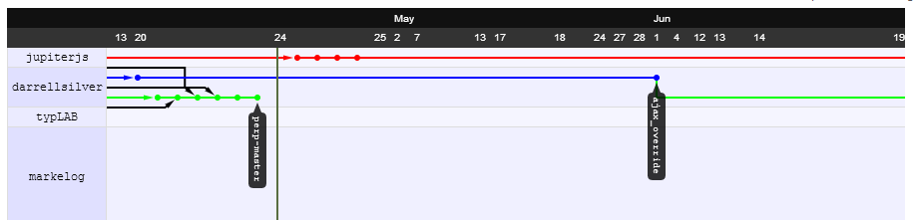
Related Work - Repository Linearization
Introduction
Motivation
Related Work
Approach
Conclusion
Evaluation
VisGi [Elsen 2013]: Focus on Branches
GitHub’s Network Graph: Focus on Branches

Slide 26
Related Work
Introduction
Motivation
Related Work
Approach
Conclusion
Evaluation
Most of the linearization tools work with CVCS’s
A few exceptions…
… which do not show where a given commit can be found
… which cannot be easily extended
No tools found for topology visualization

Slide 27
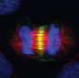
DyeVC*
Introduction
Motivation
Related Work
Approach
Conclusion
Evaluation
Committer
Date/Time
Message
Repositories relationships
...
DyeVC Database
DyeVC App
DyeVC App
DyeVC App
*Dye over Version Control

Slide 28


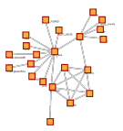

Technology Used
Introduction
Motivation
Related Work
Approach
Conclusion
Evaluation
Java Web Start
Jgit Library
JUNG* Framework
MongoDB
*Java Universal Network/Graph Framework
Notes:
JUNG: Java Universal Network/Graph Framework

Slide 29





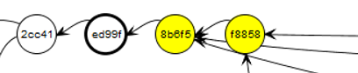
Different Visualization Levels
Introduction
Motivation
Related Work
Approach
Conclusion
Evaluation
Level 1: Repositories
Level 2: Branches
Level 3: Commits

Slide 30
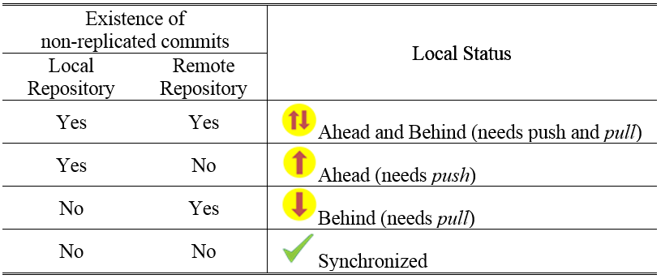
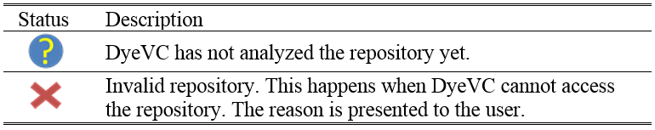
Possible state for a repository
Introduction
Motivation
Related Work
Approach
Conclusion
Evaluation

Slide 31
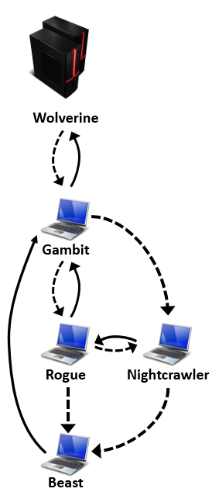
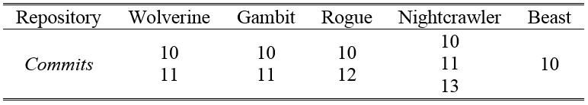
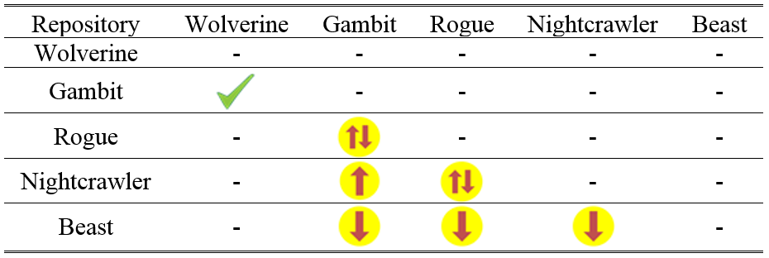
Example
Introduction
Motivation
Related Work
Approach
Conclusion
Evaluation

Slide 32
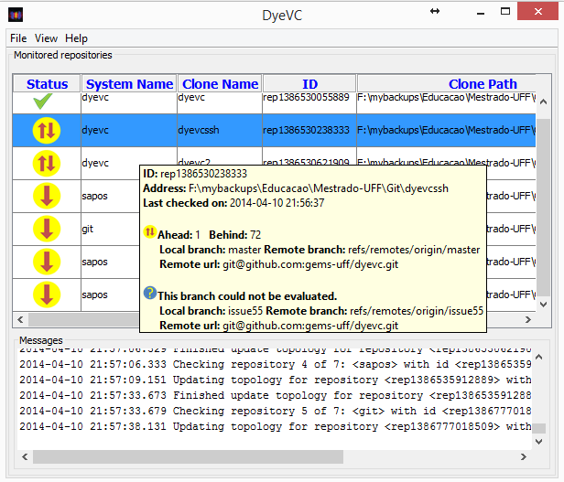
DyeVC - Main Screen
Introduction
Motivation
Related Work
Approach
Conclusion
Evaluation

Slide 33
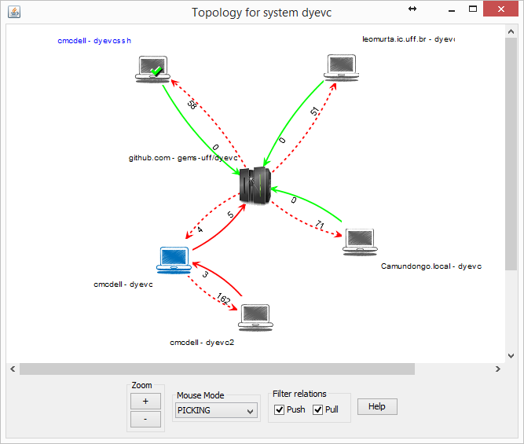
Topology View
Introduction
Motivation
Related Work
Approach
Conclusion
Evaluation

Slide 34
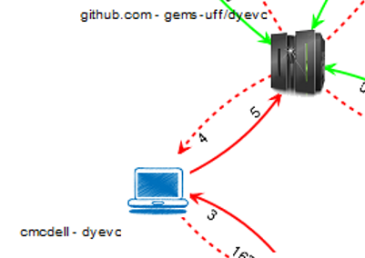
Topology View
Introduction
Motivation
Related Work
Approach
Conclusion
Evaluation
Push, synchronized
Push, not synchonized
Pull, synchronized
Pull, not synchronized

Slide 35
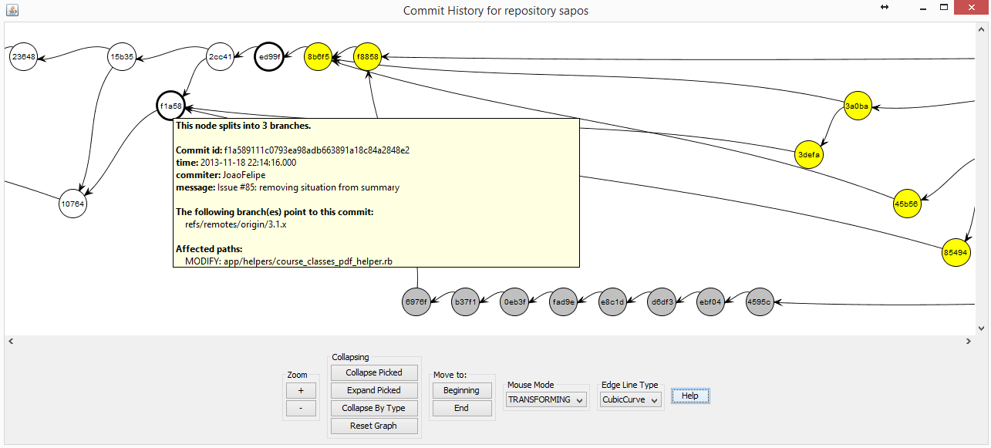
Commit History
Introduction
Motivation
Related Work
Approach
Conclusion
Evaluation

Slide 36
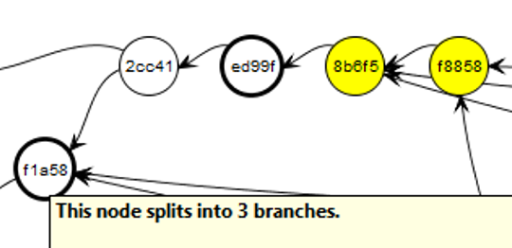
Commit History
Introduction
Motivation
Related Work
Approach
Conclusion
Evaluation

Slide 37
Commit History - Color Code
Introduction
Motivation
Related Work
Approach
Conclusion
Evaluation
Commit accessibility
Branches and Tags
Everyone has it
Regular commit
Not pushed to all partners
Pointed by a branch
Not pulled
Pointed by a tag
Exists in a non-partner
Is in a non-tracked branch

Slide 38
Evaluation
Introduction
Motivation
Related Work
Approach
Conclusion
Evaluation
Quantitative evaluation performed
Main operations measured
Open source repositories
Jgit
DyeVC
Tortoise Git
Drupal
Expresso Livre
Git

Slide 39
Evaluation
Introduction
Motivation
Related Work
Approach
Conclusion
Evaluation

Slide 40
Evaluation
Introduction
Motivation
Related Work
Approach
Conclusion
Evaluation

Slide 41
Evaluation
Introduction
Motivation
Related Work
Approach
Conclusion
Evaluation
Current limitation in commit history ≈ 7000

Slide 42
Evaluation
Introduction
Motivation
Related Work
Approach
Conclusion
Evaluation

Slide 43
Conclusion
Introduction
Motivation
Related Work
Approach
Conclusion
Evaluation
DyeVC is a non-obtrusive tool to visualize dependencies among DVCSs
Monitors repositories continuously
Extensible, allowing new plugins and layouts
Response time and scalability depends upon the desired information granularity and repository size

Slide 44
Future Work
Introduction
Motivation
Related Work
Approach
Conclusion
Evaluation
Different plugins for commit history
Collapse commits with same level of accessibility
Filter by author, date, etc.
New layouts to display different metrics
A few already created within our group
Integration with other awareness tools
E.g. Polvo, Kraken

Slide 45
References
Introduction
Motivation
Related Work
Approach
Conclusion
DyeVC homepage: http://gems.ic.uff.br/dyevc/
Source code: https://github.com/gems-uff/dyevc
User Manual: https://github.com/gems-uff/dyevc/wiki/User-Manual

Slide 46
Providing Visualizations for Distributed Version Control Systems
Thank You!
Cristiano Cesário - ccesario@ic.uff.br
Instituto de Computação – Universidade Federal Fluminense (UFF)
DyeVC is available at http://gems.ic.uff.br/dyevc

Slide 47
DyeVC
Introduction
Motivation
Related Work
Approach
Conclusion
Evaluation
Definition, according to Maletic et al*
Tasks
Audience
Target
Medium
Representation
Developer awareness
Administrator’s / Managers aid tool
Extensible platform to present information regarding DVCS
*Maletic et al. A task oriented view of software visualization
Notes:
The tasks are three-fold. First, DyeVC should work as a non-obtrusive awareness tool to increase the developer knowledge of what is going on around his repository and the repositories of his teammates. Second, DyeVC should enable repository administrators / managers to visualize how the several existing repositories of a system interact with each other. Third, DyeVC should establish an extensible platform to present different information and metrics regarding DVCS.
The audience of DyeVC is everyone involved with implementing software through the usage of distributed version control systems. The main roles that DyeVC immediately benefits are system administrators and developers, but due to its extensibility, different views can be developed to support different roles.
The target of DyeVC is any local DVCS clone of a repository hosted on a Git server, such as local Git servers, GitHub, Gitorious or Bitbucket.
The medium used by DyeVC can be a simple message in the notification area, or a window in the user’s desktop.
The representation should be appropriate to show the information in each different visualization. For instance, the various clones and their relationships use a network topology metaphor and the repository history use a directed acyclic graph visualization.
https://github.com/
https://gitorious.org/
http://bitbucket.org/

Slide 48
DyeVC
Introduction
Motivation
Related Work
Approach
Conclusion
Evaluation
Definition, according to Maletic et al*
Tasks
Audience
Target
Medium
Representation
Everyone involved with software implementation
*Maletic et al. A task oriented view of software visualization
Notes:
The tasks are three-fold. First, DyeVC should work as a non-obtrusive awareness tool to increase the developer knowledge of what is going on around his repository and the repositories of his teammates. Second, DyeVC should enable repository administrators / managers to visualize how the several existing repositories of a system interact with each other. Third, DyeVC should establish an extensible platform to present different information and metrics regarding DVCS.
The audience of DyeVC is everyone involved with implementing software through the usage of distributed version control systems. The main roles that DyeVC immediately benefits are system administrators and developers, but due to its extensibility, different views can be developed to support different roles.
The target of DyeVC is any local DVCS clone of a repository hosted on a Git server, such as local Git servers, GitHub, Gitorious or Bitbucket.
The medium used by DyeVC can be a simple message in the notification area, or a window in the user’s desktop.
The representation should be appropriate to show the information in each different visualization. For instance, the various clones and their relationships use a network topology metaphor and the repository history use a directed acyclic graph visualization.
https://github.com/
https://gitorious.org/
http://bitbucket.org/

Slide 49
DyeVC
Introduction
Motivation
Related Work
Approach
Conclusion
Evaluation
Definition, according to Maletic et al*
Tasks
Audience
Target
Medium
Representation
Any local DVCS clone of a repository hosted on a Git server
*Maletic et al. A task oriented view of software visualization
Notes:
The tasks are three-fold. First, DyeVC should work as a non-obtrusive awareness tool to increase the developer knowledge of what is going on around his repository and the repositories of his teammates. Second, DyeVC should enable repository administrators / managers to visualize how the several existing repositories of a system interact with each other. Third, DyeVC should establish an extensible platform to present different information and metrics regarding DVCS.
The audience of DyeVC is everyone involved with implementing software through the usage of distributed version control systems. The main roles that DyeVC immediately benefits are system administrators and developers, but due to its extensibility, different views can be developed to support different roles.
The target of DyeVC is any local DVCS clone of a repository hosted on a Git server, such as local Git servers, GitHub, Gitorious or Bitbucket.
The medium used by DyeVC can be a simple message in the notification area, or a window in the user’s desktop.
The representation should be appropriate to show the information in each different visualization. For instance, the various clones and their relationships use a network topology metaphor and the repository history use a directed acyclic graph visualization.
https://github.com/
https://gitorious.org/
http://bitbucket.org/

Slide 50
DyeVC
Introduction
Motivation
Related Work
Approach
Conclusion
Evaluation
Definition, according to Maletic et al*
Tasks
Audience
Target
Medium
Representation
Messages in notification area
Dialogs in user’s desktop
*Maletic et al. A task oriented view of software visualization
Notes:
The tasks are three-fold. First, DyeVC should work as a non-obtrusive awareness tool to increase the developer knowledge of what is going on around his repository and the repositories of his teammates. Second, DyeVC should enable repository administrators / managers to visualize how the several existing repositories of a system interact with each other. Third, DyeVC should establish an extensible platform to present different information and metrics regarding DVCS.
The audience of DyeVC is everyone involved with implementing software through the usage of distributed version control systems. The main roles that DyeVC immediately benefits are system administrators and developers, but due to its extensibility, different views can be developed to support different roles.
The target of DyeVC is any local DVCS clone of a repository hosted on a Git server, such as local Git servers, GitHub, Gitorious or Bitbucket.
The medium used by DyeVC can be a simple message in the notification area, or a window in the user’s desktop.
The representation should be appropriate to show the information in each different visualization. For instance, the various clones and their relationships use a network topology metaphor and the repository history use a directed acyclic graph visualization.
https://github.com/
https://gitorious.org/
http://bitbucket.org/

Slide 51
DyeVC
Introduction
Motivation
Related Work
Approach
Conclusion
Evaluation
Definition, according to Maletic et al*
Tasks
Audience
Target
Medium
Representation
According to the information in each different visualization (e.g. network topology metaphor, DAG visualization)
*Maletic et al. A task oriented view of software visualization
Notes:
The tasks are three-fold. First, DyeVC should work as a non-obtrusive awareness tool to increase the developer knowledge of what is going on around his repository and the repositories of his teammates. Second, DyeVC should enable repository administrators / managers to visualize how the several existing repositories of a system interact with each other. Third, DyeVC should establish an extensible platform to present different information and metrics regarding DVCS.
The audience of DyeVC is everyone involved with implementing software through the usage of distributed version control systems. The main roles that DyeVC immediately benefits are system administrators and developers, but due to its extensibility, different views can be developed to support different roles.
The target of DyeVC is any local DVCS clone of a repository hosted on a Git server, such as local Git servers, GitHub, Gitorious or Bitbucket.
The medium used by DyeVC can be a simple message in the notification area, or a window in the user’s desktop.
The representation should be appropriate to show the information in each different visualization. For instance, the various clones and their relationships use a network topology metaphor and the repository history use a directed acyclic graph visualization.
https://github.com/
https://gitorious.org/
http://bitbucket.org/

